Slide 1

NPTEL
Applied Accelerated Artificial Intelligence
Instructor: Dr. Satyajit Das
Dept. of Computer Science and Engineering
Indian Institute of Technology Guwahati, Assam, India

Slide 2
Segment 3: GPU Fundamentals & Modern AI Accelerators
Inside the engines of modern AI: from thousands of CUDA cores to Tensor Cores and beyond

Slide 3
Learning Objectives - Segment 3
01
Describe the SIMT (Single Instruction Multiple Threads) execution model of GPUs
02
Explain the CUDA thread hierarchy: threads, warps, blocks, and grids
03
Identify the role of Tensor Cores in matrix multiplication acceleration
04
Compare NVIDIA H100, AMD MI300X, Google TPU v4, and Graphcore IPU architectures
05
Select appropriate accelerators for training vs. inference workloads based on specifications

Slide 4
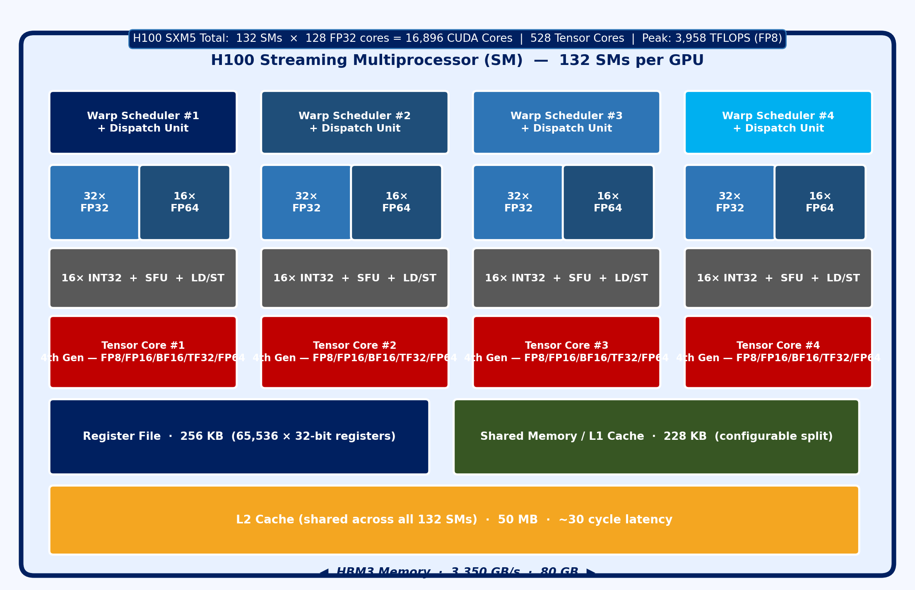
GPU Architecture: SIMT and the Streaming Multiprocessor
SIMT: Single Instruction, Multiple Threads
GPU executes thousands of threads simultaneously in lockstep groups (warps)
Warp = 32 threads executing the same instruction on different data (SIMD at scale)
Warp divergence: if-else branches cause serialisation - avoid in GPU kernels
Streaming Multiprocessor (SM) - H100 SXM
H100 SXM: 132 SMs, each with 128 CUDA cores (FP32) = 16,896 total CUDA cores
Each SM: 4 Tensor Core units, 256 KB register file, 228 KB shared memory/L1
SM executes 4 warp instructions simultaneously via 4 warp schedulers
CUDA Thread Hierarchy
Thread < Warp (32) < Block (up to 1024) < Grid (millions)
Shared memory is per-block: fast (no cache miss), programmer-managed
Global memory (HBM): accessible by all threads, high latency, high bandwidth
Fig 7: H100 Streaming Multiprocessor Architecture
Ref: NVIDIA H100 GPU Architecture Whitepaper (2022); Kirk & Hwu, “Programming Massively Parallel Processors,” 4th Ed.

Slide 5
Tensor Cores: Accelerating the GEMM at the Heart of AI
What is a Tensor Core?
Specialised fixed-function unit performing D = A*B + C (matrix multiply-accumulate) per cycle
4th Gen Tensor Core (H100): 1 TC performs 256 FP16 MACs per clock cycle
H100 SXM5: 528 Tensor Cores x 256 ops/cycle x 1.98 GHz = ~270 TFLOPS (FP16)
Supported Precisions and Use Cases
FP64: 67 TFLOPS - scientific simulation (double precision), not used in DL training
TF32 (19-bit): 989 TFLOPS - drop-in FP32 replacement for training, no code change
BF16/FP16: 1979 TFLOPS - standard for mixed-precision training (with FP32 master weights)
FP8 (E4M3/E5M2): 3958 TFLOPS - emerging standard for LLM training (Transformer Engine)
INT8/INT4: for quantised inference; INT4 = 7.9 PFLOPS - extreme throughput
Mixed Precision Training (AMP)
Weights stored in FP32 (master copy); forward/backward pass in FP16 via Tensor Cores
Loss scaling prevents FP16 underflow (gradients too small for 16-bit representation)
torch.cuda.amp.autocast() enables automatic mixed precision with one line of code
Key: Tensor Cores are only effective for large matrix shapes - small GEMM sizes underutilise them
Ref: NVIDIA Hopper Architecture In-Depth (2022); Micikevicius et al., Mixed Precision Training, ICLR 2018

Slide 6
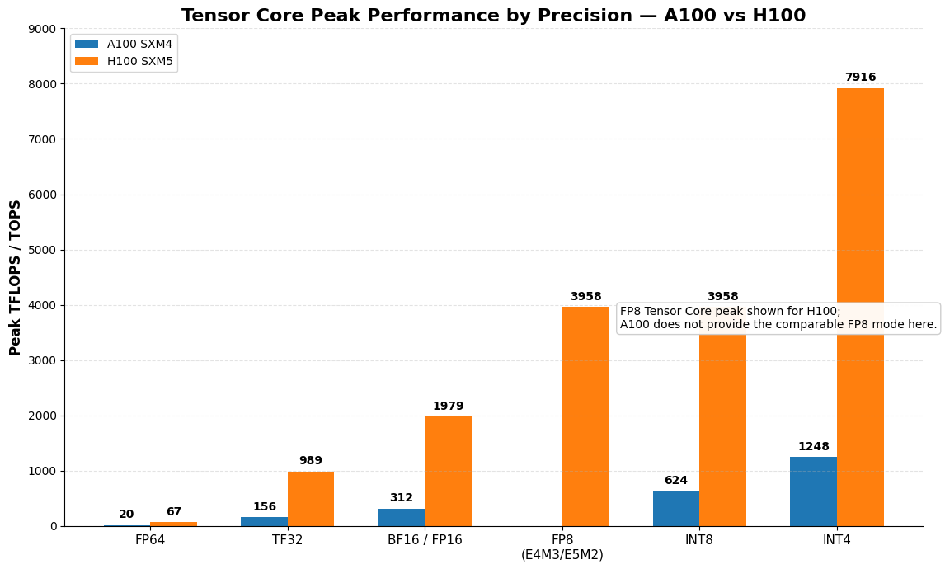
Tensor Cores: Accelerating the GEMM at the Heart of AI
Fig 8: Tensor Core Precision Modes & TFLOPS
Ref: NVIDIA Hopper Architecture In-Depth (2022); Micikevicius et al., Mixed Precision Training, ICLR 2018

Slide 7
Beyond NVIDIA: AMD, TPU, Graphcore and Custom Accelerators
AMD MI300X (2023)
13 chiplets (3nm CDNA3 + 6x HBM3): 1.307 PFLOPS FP16
192 GB HBM3 memory @ 5.3 TB/s - largest GPU VRAM available
ROCm software stack: PyTorch/JAX support via HIP (CUDA portability layer)
Best for LLM inference (huge model fits in single GPU VRAM)
Google TPU v4 (2021)
Custom ASIC: 275 TFLOPS (BF16), 32 GB HBM2e @ 1.2 TB/s
TPU Pod v4: 4096 chips interconnected via custom 3D torus network
Optimal for JAX/XLA workloads (TensorFlow, Flax), not general-purpose
Systolic array architecture: data flows through mesh of MACs without control overhead
Graphcore IPU (Intelligence Processing Unit)
1472 independent processor tiles with local SRAM (for graph neural networks)
BSP (Bulk Synchronous Parallel): compute phase alternates with communicate phase
Ideal for sparse, irregular workloads (GNNs, symbolic AI) - poor for dense GEMM
AWS Trainium & Inferentia (Custom ASICs)
Trainium2: 190.7 TFLOPS (FP16), optimised for AWS SageMaker training jobs
Inferentia2: 190 TOPS (INT8), purpose-built for low-latency inference serving
Accelerator Selection Guide
Large model training: H100 SXM or MI300X (highest HBM BW)
Cost-efficient training: A100 80GB or H100 PCIe clusters
Low-latency inference: Inferentia2, L40S, or quantised RTX 4090
Batch inference: A10G, L4, T4 (Google Cloud) - best performance/dollar
Ref: AMD MI300X Architecture Whitepaper (2023); Google TPU v4 Jouppi et al., ISCA 2023

Slide 8
GPU Memory Management and VRAM Optimisation
VRAM is the Binding Constraint in LLM Training
GPT-3 (175B params): FP16 weights = 350 GB VRAM; single H100 = 80 GB - needs 5+ GPUs
VRAM usage = weights + gradients + optimiser states + activations (all must fit simultaneously)
Adam optimiser: stores 3 copies per weight (param + momentum + variance) = 3x weight size
ZeRO (Zero Redundancy Optimiser) - Microsoft DeepSpeed
ZeRO-1: shard optimiser states across GPUs - 4x memory reduction
ZeRO-2: shard optimiser states + gradients - 8x memory reduction
ZeRO-3: shard params + gradients + optimiser states - linear scaling with GPU count
ZeRO-Offload: spill optimiser states to CPU RAM - enables 10x larger models on same GPU
Practical VRAM Budgeting Formula
Training memory (bytes) = 16 x model_params (for FP16 + AMP Adam)
Inference memory (bytes) = 2 x model_params (FP16) or 1 x model_params (INT8)
Activation memory per layer proportional to batch_size x seq_len x hidden_dim
Tool: nvidia-smi --query-gpu=memory.used,memory.free --format=csv
Tool: torch.cuda.memory_summary() for detailed per-tensor breakdown
Ref: Rajbhandari et al., “ZeRO: Memory Optimizations Toward Training Trillion Parameter Models,” SC’20

Slide 9
Segment 3 Summary: GPU Fundamentals & AI Accelerators
GPUs execute thousands of threads in warps (32) via SIMT; occupancy and warp scheduling hide memory latency
Tensor Cores perform matrix MACs per cycle: H100 reaches 3958 TFLOPS (FP8) - 600x vs single CPU core
HBM3 (3.35 TB/s) is the defining bandwidth advantage of the H100; AMD MI300X offers 192 GB / 5.3 TB/s
TPUs (systolic arrays), IPUs (tile-based), and cloud ASICs offer architecture diversity for specific workloads
ZeRO-3 sharding and gradient checkpointing are essential techniques for training beyond single-GPU VRAM limits

Slide 10
Thank you!

